Slide 1
EXPLORATORY PROJECT
APPLICATION OF MACHINE LEARNING IN STRUCTURAL HEALTH MONITORING
NAME:GUNJAN KSHIRSAGAR ROLL NO:21065058

Slide 2
WHY STRUCTURAL HEALTH MONITORING IS NEEDED?
Structural health monitoring is need to visualize hidden damage inside infrastructure.
Structural health monitoring aims to identify , detect and characterize the degradation and damage of all types of Engineering Structure like highways , railways , bridges , buildings etc .
Objective :- Accurately identify the current state of health and behaviour of the structure by using monitored data.

Slide 3
BENEFITS OF SHM :
MAINTENANCE /OPERABILITY
Enhance reliability, safety , availability.
Minimize downtime.
Reduce overall maintenance costs.
Provide improvement in designs and construction.
DESIGNS
Optimize structural efficiency.
Develop new design philosophies.
Save weight.

Slide 4
APPROACH OF SHM
1) PHYSICS-BASED
Vibration- based SHM (MATLAB FE-MODEL)
Bridge Weigh-in-Motion
2) DATA-DRIVEN (ANNs and ML)
Artificial Neural Network (ANNs) Model
1: Dynamic of beams (forward problem)
2: Dynamic of beams using sensor array for full-field prediction

Slide 5
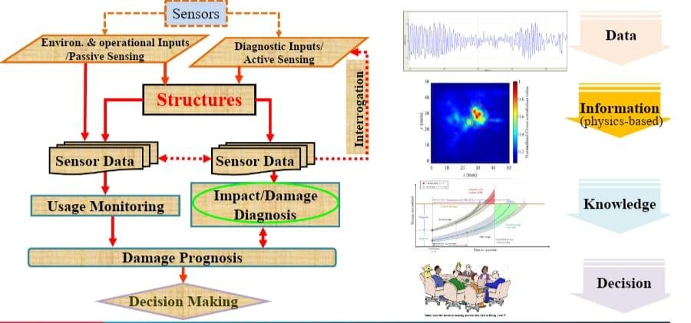
SHM SYSTEM FRAMEWORK

Slide 6
CHALLENGES:-
Limited number of sensor available
Big data (including historical data and sensor modalities)
Small or insufficient sample for damage scenarios
Sensitivity of modal parameters
Measurement noise and modelling error

Slide 7






PROCESSING OF DATA
The process of SHM , overall software system like:-
Microcontroller units
Intelligent Sensor
Update Report to Computer
Human Interference Checking data
Retrieve
data
Condense data
Sorting
data
Analysis
data
Get data

Slide 8
INTRODUCTION TO MACHINE LEARNING
Machine learning is an application of artificial intelligence that involves algorithms and data that automatically analyse and make decision by itself without human intervention. It describes how computer perform tasks on their own by previous experiences.
The difference between normal computer software and machine learning is that a human developer has not given codes that instructs the system how to react to situation
,instead it is being trained by a large number of data.

Slide 9
TYPES OF MACHINE LEARNING
There are three types of machine learning
Supervised Learning
Unsupervised Learning
Reinforcement Learning

Slide 10
INTRODUCTION OF ALL TYPES OF ML
SUPERVISED LEARNING : learning is a technique where the program is given labelled input data and the expected output data , ex self driving car.
UNSUPERVISED LEARNING : This type of algorithm consist of input data without labelled response. There will not be any pre existing labels and human intervention is also less.
Unsupervised learning is mostly used in exploratory analysis as it can
automatically Identify the structure in data.
REINFORCEMENT LEARNING : This model is used in making sequence of decision. It is learning by interaction with the Environment . It can be said that it is an trail and error method in finding the best outcome based on experience .

Slide 11
APPLICATION OF MACHINE LEARNING
Self Driving Car
Email Spam Filtering
Traffic Predication (GPS navigation service out location )
Online Transportation (Estimate cost and distance of the travel)
Social Media Services ( app like Facebook personalizing our news feed)
Product Recommendation (in online shopping while search for a product all its relavant product are display in our screen )

Slide 12
ADVANTAGES OF MACHINE LEARNING
Wide range of real life application
Fast , Accurate , Efficient
Handing Multi-dimensional data
No human intervention is needed
Enhanced cyber security and spam detection
Automation of most application

Slide 13
DISADVANTAGES OF MACHINE LEARNING
It is very difficult to identify and rectify the error
Data Acquisition
Interpretation of results requires more time and space

Slide 14
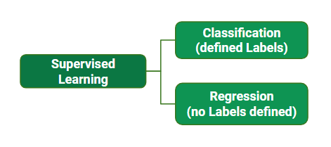
SUPERVISED LEARNING
A) Classification –
It is task where output is having defined labels (Discrete value).
There are two type of output class
Binary classification (Either 0 or 1 and Yes or No)
Multi-class classification (Gmail classifies like social , promotions , update)
B) Regression
It is a supervised task where output is having continuous value .
The goal here is to predict a value as much closer to the actual output value as our model can and then evaluation is done by calculation the error value . Smaller the error the greater the accuracy of our regression model.

Slide 15
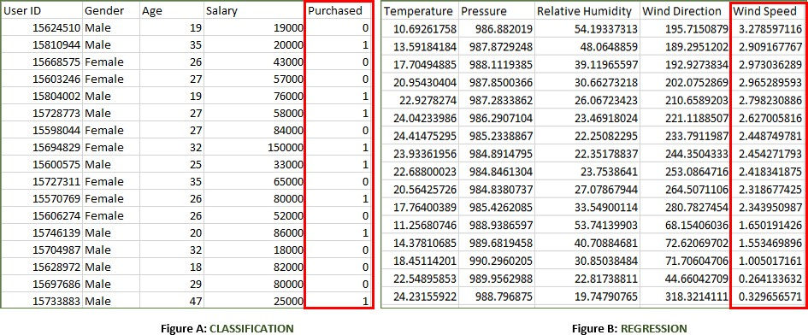
Example of classification and regression

Slide 16
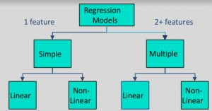
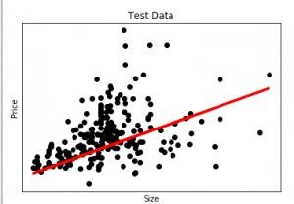
IMPORTANT OF SUPERVISED LEARNING AND TYPE OF REGRESSION MODEL
Supervised learning which means that the output variable is already known . The goal of supervised learning is to learn a function that can accurately predict the output variable based on the input variable.
Supervised learning algorithms are widely used in various field , such as natural language processing , computer vision , medical diagnosis , speech recognition , linear regression ,logistic regression ,support vector machine (SVM),Neural network.
Type of regression models:
EX: Predict the price of the house (Housing data set)
red line predicting price

Slide 17
UNSUPERVISED LEARNING
Unsupervised learning is the training of a machine using information that is neither classified nor labelled and allowing the algorithm to act on the information without guidance.
Here the task of the machine is to group unsorted information according to similarities , patterns
, and differences without any prior training of data.
Supervised learning : model where input variable (say , x) and output variable (say , y) and an algorithm to map the input to the output that is , Y=f(x).
Unsupervised learning : is where only input data (say , x) is present and no corresponding output variable is there.
The main aim of unsupervised learning is to model the distribution in the data in order to learn more about the data. Algorithms are left to their own devises to discover and present the interesting structure in the data.

Slide 18
Example of Unsupervised learning
Suppose there is a basket and it is filled with some fresh fruits. The task is to arrange the same type of fruits at one place.
This time there is no information about those fruits beforehand, its the first time that the fruits are being seen or discovered So how to group similar fruits without any prior knowledge about those. First, any physical characteristic of a particular fruit is selected. Suppose color. Then the fruits are arranged on the basis of the color.
The groups will be something as shown below: fruit are classified on basis of color and size
RED COLOR GROUP: apples & cherry fruits. GREEN COLOR GROUP: bananas & grapes.
RED COLOR AND BIG SIZE: apple. RED COLOR AND SMALL SIZE: cherry fruits.
GREEN COLOR AND BIG SIZE: bananas. GREEN COLOR AND SMALL SIZE: grapes

Slide 19
Difference Between supervised and unsupervised data
Supervise learning
classifying big data can be challenging.
allows collecting data and produces data output from previous experience.
It allows estimating or mapping the result to a new sample.
Cannot handle all complex tasks in machine learning.
Unsupervised learning
It does not require a training data to be labelled.
Capable of finding previously unknow patterns in data.
the result often less accuracy .

